Slide 1
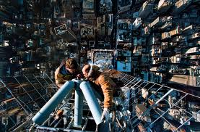
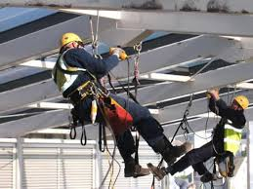
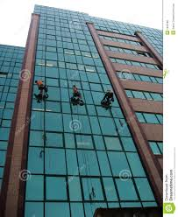
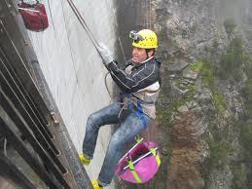
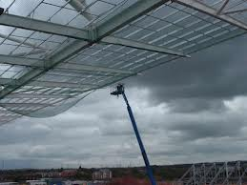
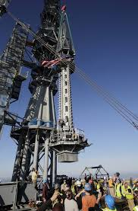
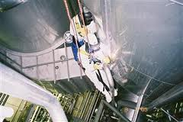
IF IT’S IN THE AIR… WE’RE THERE
At 2Hi4U Air Access Australia, we specialize in providing quality access services.
We provide customized access solutions across a wide array of industries including commercial, industrial , mining and residential.
Our fully experienced staff have a combined 20 years experience and pride themselves in excellence, safety and precision.
Safety is always our first priority
Our Services Include:
-Commercial Outdoor Maintenance
-Mining & Rig Installation
-Infrastructure services
-Consultation services
-Residential Services
Contact Details:
Jason Puru 0414775781
Email: jrpvip@hotmail.com
www.2hi4u.com.au

